Slide 1
Some numbers and their ‘meaning’
These numbers occur very frequently in discussion
0x 80000000 = 2 GB = KERNBASE
0x 100000 = 1 MB = EXTMEM
0x 80100000 = 2GB + 1MB = KERNLINK
0x E000000 = 224 MB = PHYSTOP
0x FE000000 = 3.96 GB = 4064 MB = DEVSPACE
  4096 – 4064 = 32 MB left on top

Slide 2
X86 Memory Management

Slide 3

X86 address : protected mode address translation

Slide 4

X86 segmentation

Slide 5

X86 paging

Slide 6
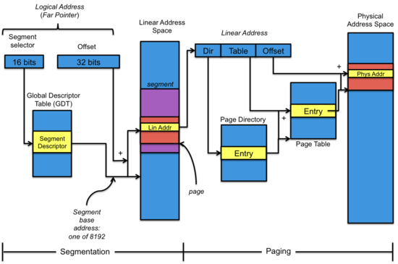
Segmentation + Paging

Slide 7

Segmentation + Paging
Selector value is implicit based on address being accessed.
Instruction: CS
Stack Variable: SS
Data: DS
etc.

Slide 8

GDT Entry

Slide 9

Page Directory Entry (PDE)
Page Table Entry (PTE)

Slide 10


Segment selector
EFLAGS register

Slide 11

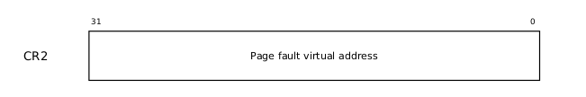
CR0
CR2
PG: Paging enabled or not WP: Write protecion on/off
PE: Protection Enabled --> protected mode.

Slide 12


CR3
CR4

Slide 13

Layout of process’s VA space

Slide 14

Memory Layout of a user process
After exec()
Note the argc, argv on stack
The “guard page” is just a mapping in page table. No frame allocated. It’s marked as invalid. So if stack grows (due to many function calls), then OS will detect it with an exception

Slide 15
Memory Layout of a user process
On sbrk()
The system call to grow process’s address space. Calls growproc()
growproc()
Allocate a frame, Add an entry in page table at the top (above proc->sz)
//This entry can’t go beyond KERNBASE
Calls switchuvm()
Switchuvm()
Ultimately loads CR3, invalidating cache

Slide 16
mmu.h : paging related macros
#define PTXSHIFT 12 // offset of PTX in a linear address
#define PDXSHIFT 22 // offset of PDX in a linear address
#define PDX(va) (((uint)(va) >> PDXSHIFT) & 0x3FF)// page directory index
#define PTX(va) (((uint)(va) >> PTXSHIFT) & 0x3FF)// page table index
// construct virtual address from indexes and offset
#define PGADDR(d, t, o) ((uint)((d) << PDXSHIFT | (t) << PTXSHIFT | (o)))
// +--------10------+-------10-------+---------12----------+
// | Page Directory | Page Table | Offset within Page |
// | Index | Index | |
// +----------------+----------------+---------------------+
// \--- PDX(va) --/ \--- PTX(va) --/

Slide 17
mmu.h : paging related macros
// Page directory and page table constants.
#define NPDENTRIES 1024 // # directory entries per page directory
#define NPTENTRIES 1024 // # PTEs per page table
#define PGSIZE 4096 // bytes mapped by a page
#define PGROUNDUP(sz) (((sz)+PGSIZE-1) & ~(PGSIZE-1))
#define PGROUNDDOWN(a) (((a)) & ~(PGSIZE-1))

Slide 18
mmu.h : paging related macros
// Page table/directory entry flags.
#define PTE_P 0x001 // Present
#define PTE_W 0x002 // Writeable
#define PTE_U 0x004 // User
#define PTE_PS 0x080 // Page Size
// Address in page table or page directory entry
#define PTE_ADDR(pte) ((uint)(pte) & ~0xFFF) // get all but last 12 bits
#define PTE_FLAGS(pte) ((uint)(pte) & 0xFFF) // get last 12 bits

Slide 19
mmu.h : Segmentation related macros
// various segment selectors.
#define SEG_KCODE 1 // kernel code
#define SEG_KDATA 2 // kernel data+stack
#define SEG_UCODE 3 // user code
#define SEG_UDATA 4 // user data+stack
#define SEG_TSS 5 // this process's task state

Slide 20
mmu.h : Segmentation related macros
// various segment selectors.
#define SEG_KCODE 1 // kernel code
#define SEG_KDATA 2 // kernel data+stack
#define SEG_UCODE 3 // user code
#define SEG_UDATA 4 // user data+stack
#define SEG_TSS 5 // this process's task state
#define NSEGS 6

Slide 21
mmu.h : Segmentation related macros
struct segdesc { // 64 bit in size
uint lim_15_0 : 16; // Low bits of segment limit
uint base_15_0 : 16; // Low bits of segment base address
uint base_23_16 : 8; // Middle bits of segment base address
uint type : 4; // Segment type (see STS_ constants)
uint s : 1; // 0 = system, 1 = application
uint dpl : 2; // Descriptor Privilege Level
uint p : 1; // Present
uint lim_19_16 : 4; // High bits of segment limit
uint avl : 1; // Unused (available for software use)
uint rsv1 : 1; // Reserved
uint db : 1; // 0 = 16-bit segment, 1 = 32-bit segment
uint g : 1; // Granularity: limit scaled by 4K when set
uint base_31_24 : 8; // High bits of segment base address
};

Slide 22
mmu.h : Segmentation related code
// Application segment type bits
#define STA_X 0x8 // Executable segment
#define STA_W 0x2 // Writeable (non-executable segments)
#define STA_R 0x2 // Readable (executable segments)
// System segment type bits
#define STS_T32A 0x9 // Available 32-bit TSS
#define STS_IG32 0xE // 32-bit Interrupt Gate
#define STS_TG32 0xF // 32-bit Trap Gate

Slide 23
Code from bootasm.S bootmain.c is over!
Kernel is loaded.
Now kernel is going to prepare itself

Slide 24
main() in main.c
Initializes “free list” of page frames
  In 2 steps. Why?
Sets up page table for kernel
Detects configuration of all processors
Starts all processors
  Just like the first processor
Creates the first process!
Initializes
  LAPIC on each processor, IOAPIC
  Disables PIC
  “Console” hardware (the standard I/O)
  Serial Port
  Interrupt Descriptor Table
  Buffer Cache
  Files Table
  Hard Disk (IDE)

Slide 25
main() in main.c
int
main(void) {
kinit1(end, P2V(4*1024*1024)); // phys page allocator
kvmalloc(); // kernel page table
void
kinit1(void *vstart, void *vend) {
initlock(&kmem.lock, "kmem");
kmem.use_lock = 0;
freerange(vstart, vend);
}

Slide 26
main() in main.c
kfree(char *v) {
struct run *r;
if((uint)v % PGSIZE || v < end || V2P(v) >= PHYSTOP)
panic("kfree");
// Fill with junk to catch dangling refs.
memset(v, 1, PGSIZE);
if(kmem.use_lock)
acquire(&kmem.lock);
r = (struct run*)v;
r->next = kmem.freelist;
kmem.freelist = r;
if(kmem.use_lock)
release(&kmem.lock); }
void
freerange(void *vstart, void *vend)
{
char *p;
p = (char*)PGROUNDUP((uint)vstart);
for(; p + PGSIZE <= (char*)vend; p += PGSIZE)
kfree(p);
}

Slide 27
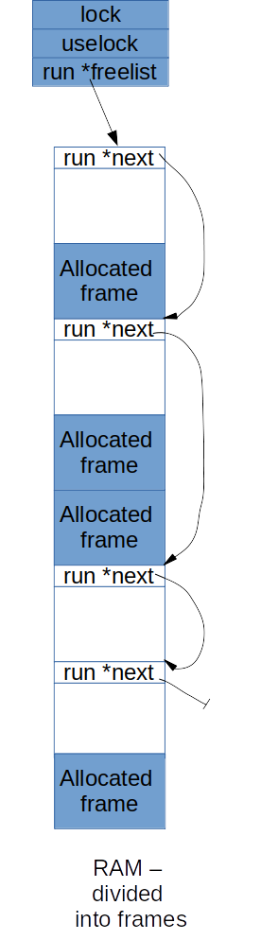
Free List in XV6 Obtained after main() -> kinit1()
Pages obtained Between
end = 801154a8 = 2049 MB to P2V(4MB) = 2052 MB
Remember
Right now Logical = Physical address.
Actually like
this in memory
lock
kmem
uselock
Seen independently
run *freelist
run *
run *
run *

Slide 28
Back to main()
// Allocate one page table for the machine for the kernel address
// space for scheduler processes.
void
kvmalloc(void)
{
kpgdir = setupkvm();
switchkvm();
}
int
main(void) {
kinit1(end, P2V(4*1024*1024)); // phys page allocator
kvmalloc(); // kernel page table

Slide 29
Back to main()
// Allocate one page table for the machine for the kernel address
// space for scheduler processes.
void
kvmalloc(void)
{
kpgdir = setupkvm(); // global var kpgdir
switchkvm();
}
int
main(void) {
kinit1(end, P2V(4*1024*1024)); // phys page allocator
kvmalloc(); // kernel page table

Slide 30
pde_t*
setupkvm(void)
{
pde_t *pgdir;
struct kmap *k;
if((pgdir = (pde_t*)kalloc()) == 0)
return 0;
memset(pgdir, 0, PGSIZE);
if (P2V(PHYSTOP) > (void*)DEVSPACE)
panic("PHYSTOP too high");
for(k = kmap; k < &kmap[NELEM(kmap)]; k++)
if(mappages(pgdir, k->virt, k->phys_end - k->phys_start,
(uint)k->phys_start, k->perm) < 0) {
freevm(pgdir);
return 0;
}
return pgdir;
}

Slide 31
static struct kmap {
void *virt;
uint phys_start;
uint phys_end;
int perm;
} kmap[] = {
{ (void*)KERNBASE, 0, EXTMEM, PTE_W}, // I/O space
{ (void*)KERNLINK, V2P(KERNLINK), V2P(data), 0}, // kern text+rodata
{ (void*)data, V2P(data), PHYSTOP, PTE_W}, // kern data+memory
{ (void*)DEVSPACE, DEVSPACE, 0, PTE_W}, // more devices
};

Slide 32
kmap[] mappings done in kvmalloc(). This shows segmentwise, entries are done in page directory and page table for corresponding VA-> PA mappings
4B
DEVSPACE=3.96GB
KERNBASE+PHYSTOP=2.224GB= 2272MB
data= 2049.3125 MB
KERNBASE+EXTMEM=2049 MB
KERNBASE=2048MB
0
Un
mapped
4GB
DEVSPACE=3.96GB
PHYSTOP = 224MB
1.03125 MB = 1MB + data
EXTMEM=1MB
0
Unused
Kernel
data
+ memory
Kernel
data
+ memory
Kernel
code +
RO Data
I/O Space
Kernel
code +
RO Data
Process
address
space
I/O Space
Physical Memory
0x80108000 =data = 2049.3125 MB
Is obtained from kernel.sym
Logical Address space

Slide 33
Remidner: PDE and PTE entries

Slide 34
Before mappages()
pgdir

Slide 35
4K
Page-no,UWP
Page-no,UWP
Page-no,UWP
Page-no,UWP
Page-no,UWP
Page-no,UWP
Page-no,UWP
Page-no,UWP
Page-no,UWP
pgdir
4K
What mappages()
Does

Slide 36
After kvmalloc() in main()
RAM
Physical Addr
Logical Address = offset
Linear Address
Dir
pg
Offset
4MB
0
CS, SS, etc.
Selector
Base | Limit | Permissions
0 | 4GB | Write
0 | 4GB | Read, Execute
0 | 0 | 0
3
2
1
0
DS
SS
Page Table
GDT
CS
CR3
Now Linear Address = Logical Address != Physical Address
kpgdir

Slide 37
main()->seginit()
Re-initialize GDT
Once and forever now
Just set 4 entries
  All spanning 4 GB
  Differing only in permissions and privilege level

Slide 38
After seginit() in main().
On the processor where we started booting
RAM
Physical Addr
Logical Address = offset
Linear Address
Dir
pg
Offset
4MB
0
CS, SS, etc.
Selector
Base | Limit | Permissions | DPL
0 | 4GB | Write | 3
0 | 4GB | Read, Execute | 3
0 | 4GB | Write | 0
0 | 4GB | Read, Execute | 0
0 | 0 | 0
4
3
2
1
0
DS
SS
Page Table
GDT
CS
Now Linear Address = Logical Address != Physical Address
CR3
kpgdir

Slide 39
After seginit()
While running kernel code, necessary to switch CS, DS, SS to index 1,2,2 in GDT
While running user code, necessary to switch CS, DS, SS to index 3,4,4 in GDT
This happens automatically as part of “trap” handling (covered separately)

Slide 40
Memory Management

Slide 41
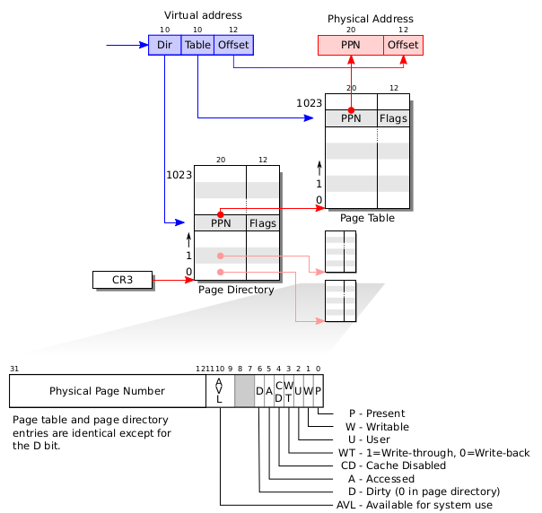
X86 page table hardware

Slide 42
Layout of process’s VA space

Slide 43
Memory Layout of a user process
After exec()
Note the argc, argv on stack

Slide 44
Memory Layout of a user process
The “guard page” is just a mapping in page table. No frame allocated. It’s marked as invalid. So if stack grows (due to many function calls), then OS will detect it with an exception

Slide 45
Memory Layout of a user process
On sbrk()
The system call to grow process’s address space. Calls growproc()
growproc()
Allocate a frame, Add an entry in page table at the top (above proc->sz)
//This entry can’t go beyond KERNBASE
Calls switchuvm()
Switchuvm()
Ultimately loads CR3, invalidating cache

Slide 46
Free List in XV6
Actually like
this in memory
lock
kmem
uselock
Seen independently
run *freelist
run *
run *
run *

Slide 47
exec()
sys_exec()
  exec(path, argv)
exec(parth, argv)
  ip = namei(path))
  readi(ip, (char*)&elf, 0, sizeof(elf)) != sizeof(elf)
  for(i=0, off=elf.phoff; i<elf.phnum; i++, off+=sizeof(ph)){
  if(readi(ip, (char*)&ph, off, sizeof(ph)) != sizeof(ph))
  if((sz = allocuvm(pgdir, sz, ph.vaddr + ph.memsz)) == 0)
  if(loaduvm(pgdir, (char*)ph.vaddr, ip, ph.off, ph.filesz) < 0)
  }

Slide 48
exec()
exec(parth, argv)
  // Allocate two pages at the next page boundary.
  // Make the first inaccessible. Use the second as the user stack.
  sz = PGROUNDUP(sz);
  if((sz = allocuvm(pgdir, sz, sz + 2*PGSIZE)) == 0)
  // Push argument strings, prepare rest of stack in ustack.
  for(argc = 0; argv[argc]; argc++) {
  sp = (sp - (strlen(argv[argc]) + 1)) & ~3;
  if(copyout(pgdir, sp, argv[argc], strlen(argv[argc]) + 1) < 0)

